Slide 1
DATA VISUALIZATION
Applications using R
Jordache Ramjith

Slide 2
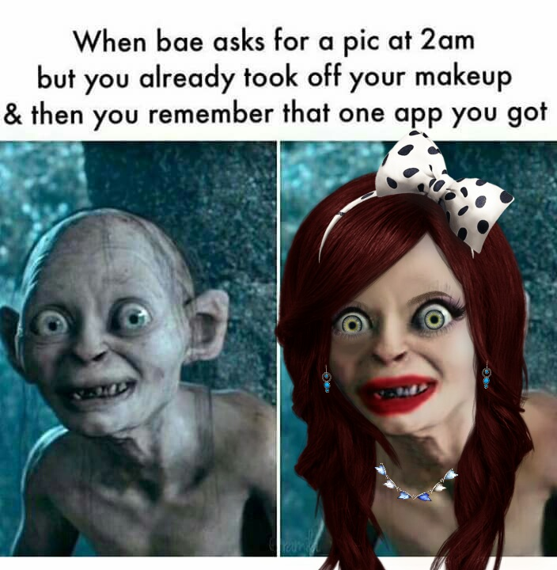
Online dating
Online dating obviously has roots in the classifieds.
Pictures & profiles.
“If you don’t look like your pictures when we meet, you will buy be drinks until you do” – Anonymous tinder guy

Slide 3
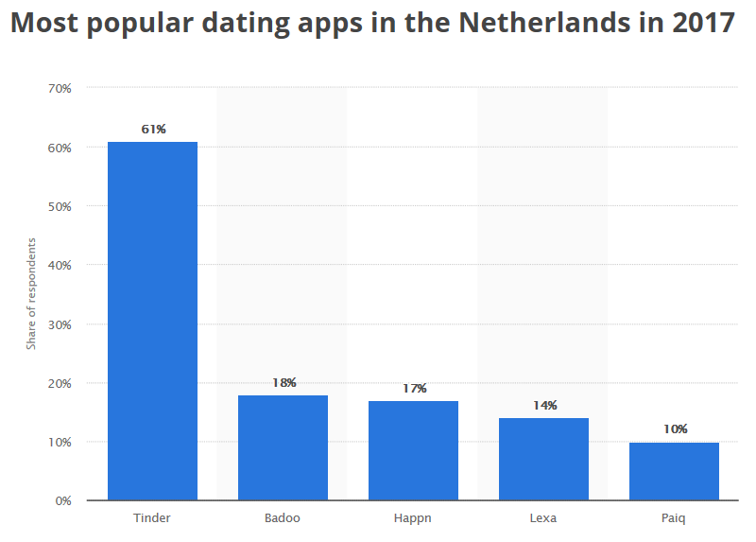
Dutch popular sites?

Slide 4
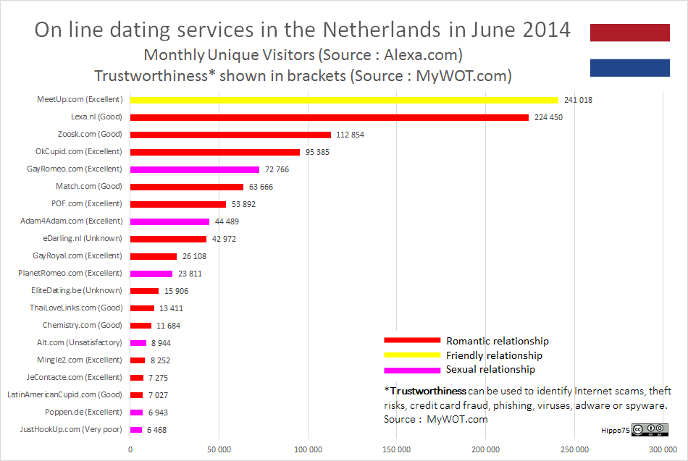

Slide 5
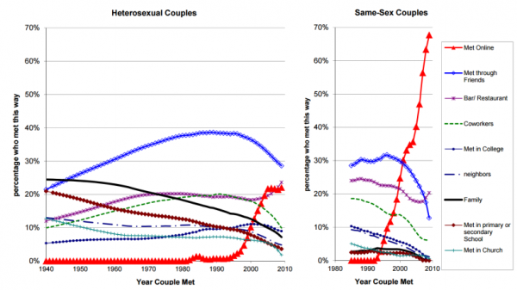
Other interesting statistics

Slide 6
